Slide 1

Angular
Instructor : Youssef RAFII
12,13,15 and 16 August 2020

Slide 2

Training plan
ANGULAR
First Day
Introduction & Versions
Basics
Second Day
Databinding
Third Day
Pipes
Routing
Forms: Reactive
Making Http Requests
Directives
Observables
Installation
Services & Dependency Injection
Forms: Template driven
Fourth Day
Authentication

Slide 3
First Day
Introduction & Versions
Installation
Basics
Directives

Slide 4
Introduction & Versions

Slide 5

Introduction & Versions
ANGULAR
From Official Angular Web site
“Angular is an app-design framework and development platform for creating efficient and sophisticated single-page apps.”

Slide 6
Introduction & Versions
ANGULAR
2
May 2016
Complete Re-Write of AngularJs
OOP

Slide 7
Introduction & Versions
ANGULAR
Released on March 23, 2017.
Angular 2 compatible
Skipping V3 to avoid a confusion due to the misalignment of the router package's version
Lot of performance improvement
Introducing HttpClient, a smaller, easier to use, and more powerful library for making HTTP Requests (Make http API as deprecated).
Conditionally disable animations
4

Slide 8
Introduction & Versions
ANGULAR
Released on November 1, 2017
Build optimizations
Improvements of the perfs
Compiler Improvements.
Build Optimizer and improvements of Material Desing.
5

Slide 9
Introduction & Versions
ANGULAR
Released on May 4, 2018
No major breaking changes
RxJS v6
Angular CLI Changes: Two new commands have been introduced
— ng update <package> — ng add <package>
6

Slide 10
Introduction & Versions
ANGULAR
7
Released on October 18, 2018
TypeScript 3.1 Support
Angular CLI prompt user

Slide 11
Introduction & Versions
ANGULAR
8
Released on May 28, 2019
Internal changes
@angular/http is no longer supported, use @Angular/common/http instead
ViewChild changed temporary

Slide 12
Introduction & Versions
ANGULAR
was released on February 6, 2020
Internal changes
Faster testing
Improved CSS class and style binding
ViewChild returned as before
9

Slide 13
Introduction & Versions
ANGULAR
was released on June 24, 2020
Internal changes
Keeping Up to Date with the Ecosystem(TypeScriptTypeScript 3.9, TSLint v6)
made several new deprecations and removals from Angular.
10

Slide 14
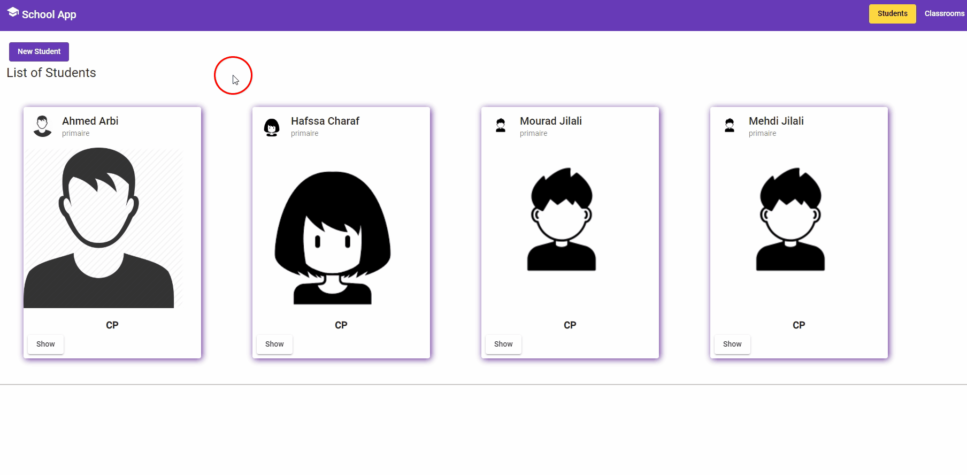
What will be done during this training
ANGULAR

Slide 15
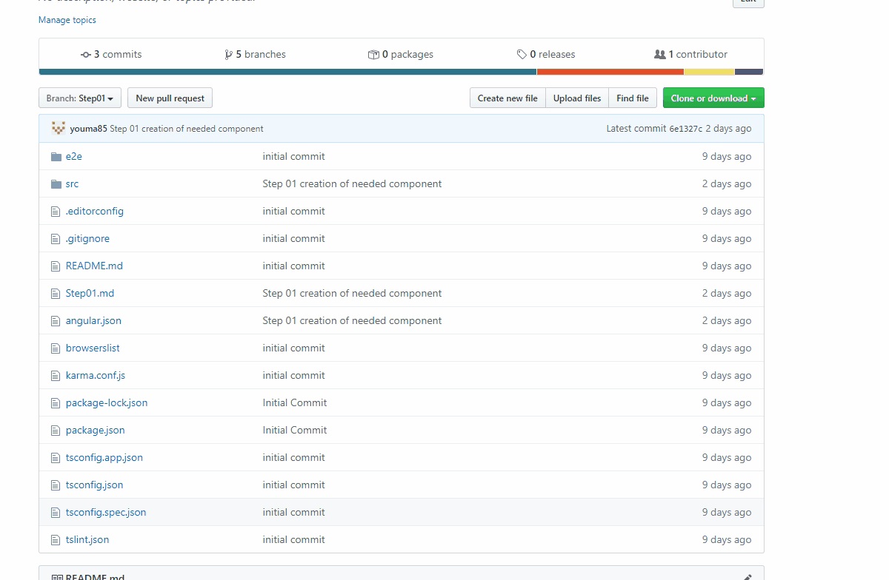
Code in a git repository by Steps
ANGULAR

Slide 16
Installation

Slide 17




Setup Environment
ANGULAR
 | Node JS | https://nodejs.org/en/download/releases/
 | Git | https://git-scm.com/downloads
 | VsCode | https://code.visualstudio.com/
 | Angular Cli | https://cli.angular.io/

Slide 18

Node Js
ANGULAR
Angular requires a current, active LTS, or maintenance LTS version of Node.js.
Download the current version from here: https://nodejs.org/en/download/current/
To check your version, run:
node -v in a terminal/console window.

Slide 19

Angular Cli
ANGULAR
Installation:
npm install -g @angular/cli
Update to the latest version:
npm uninstall -g @angular/cli
npm cache clean –force
npm install -g @angular/cli

Slide 20
CLI Overview
ANGULAR
ng add: Adds support for an external library to your project.
ng build(ng b): Compiles an Angular app into an output directory named dist/ at the given output path.
ng deploy: Invokes the deploy builder for a specified project or for the default project in the workspace.
ng doc (ng d): Opens the official Angular documentation (angular.io) in a browser, and searches for a given keyword.
ng generate(ng g): Generates files based on a schematic.
For more informations:
https://angular.io/cli

Slide 21

Basics

Slide 22
Angular
ANGULAR
“Angular is a platform and framework for building single-page client applications using HTML and TypeScript. Angular is written in TypeScript. It implements core and optional functionality as a set of TypeScript libraries that you import into your apps.”: From the Official WebSite.
The basic building blocks are NgModules, which provide a compilation context for components.
An app always has at least a root module that enables bootstrapping, and typically has many more feature modules.

Slide 23
Create new Angular App
ANGULAR
Run the CLI command ng new and provide the name as shown here:
ng new my-app
The ng new command prompts you for information about features to include in the initial app. Accept the defaults by pressing the Enter or Return key.
Go to the workspace folder (my-app).
Launch the server by using the CLI command ng serve, with the --open option:
cd my-app
ng serve
The ng serve command launches the server, watches your files, and rebuilds the app as you make changes to those files.

Slide 24
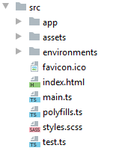
The contents src folder
ANGULAR
Asset | Role
app | Contains the primary App component and module
assets | Empty directory to store static assets like images
environments | Environment configurations to allow you to build for different targets, like dev, qualification or production
favicon.ico | Image displayed as browser favorite icon
index.html | Root HTML file for the application
main.ts | Entry point for the web application code
polyfills.ts | Imports some common polyfills required to run Angular properly on some browsers
styles.css | Global stylesheet
test.ts | Unit test entry point, not part of application

Slide 25
App component
ANGULAR
App component is the root of the application
@Component({ selector: 'app-root', templateUrl: './app.component.html', styleUrls: ['./app.component.scss'] }) export class AppComponent { }
Import the component annotation
Define the component
and its properties
Create the component controller,
This component is used in the src/index.html file which is the HTML page hosting the Angular application.

Slide 26
App module
ANGULAR
The App module is the packaging that tells Angular what’s available to render
import { BrowserModule } from '@angular/platform-browser'; import { NgModule } from '@angular/core'; import { AppComponent } from './app.component'; @NgModule({ declarations: [ AppComponent ], imports: [ BrowserModule ], providers: [], bootstrap: [AppComponent] }) export class AppModule { }
Imports Angular dependencies needed
Imports the App component
Uses the NgModule annotation to define a module by passing an object
Declarations are to list any components and directives used in the app.
Imports are other modules that are used in the app.
Providers are any services used in the app.
Bootstrap declares which component to use as the first to bootstrap the application.
The "root module" is a classic module whose particularity is to define the "root component" of the application via the bootstrap property.

Slide 27
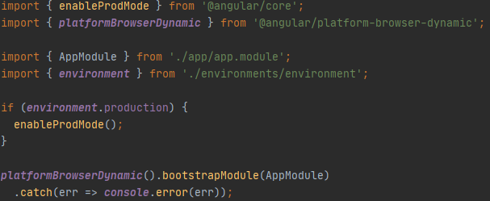
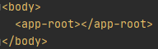
Bootstrapping the app
ANGULAR
main.ts
If production is enabled, turn off Angular developer mode.
Bootstraps the App module
index.html
Angular will look for the app-root element and replace it with the rendered component.

Slide 28
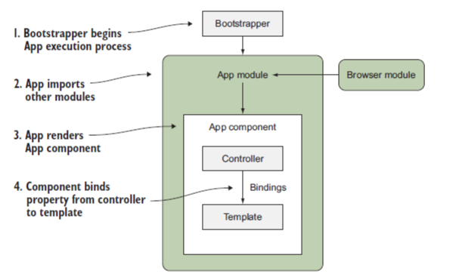
Bootstrapping the app
ANGULAR
Notes:
Immediately upon loading the page, the bootstrapper is called to begin Angular execution.
Now that Angular has started, it loads your App module and reads through any additional dependencies that need to be loaded and bootstrapped.
Then Angular renders the App component, which is the root element of the application.

Slide 29
Basics: Modules (definition)
ANGULAR
Angular offers a concept of modules to better structure the code and facilitate reuse and sharing.
An Angular module is a mechanism allowing to:
group together components (but also services, directives, pipes, etc.),
define their dependencies,
and define their visibility.
An Angular module is defined simply with a class (usually empty) and the NgModule decorator.
Notes:
Angular components form the data structure of your application. The HTML template associated with a component provides the means to display that data in the context of a web page. Together, a component's class and template form a view of your application data.
https://angular.io/guide/displaying-data

Slide 30
Basics: Modules(definition)
ANGULAR
declarations:
Defines the list of components (or directives, pipes etc ...) contained in this module.
exports:
Defines the list of components that can be used by modules that import this one.
imports:
Defines the list of module dependencies. This is usually the list of modules containing the components used by the components in the declarations section

Slide 31
Basics: Modules(imports)
ANGULAR
Module
Component
Import
App Module
Component(Not exported)
Can use
Can not use
Import
Module 1
Module 2
Notes:
App Module import Module 1: so it can use only component exported
Module 1 import Module 2

Slide 32
Basics: Modules(Types)
ANGULAR
Root Module
Shared Module
The Shared Module is where we want to store common modules, components, etc. Everything is shared throughout the application.
Core Module
Feature Module
The Core Module is where we want to put our shared singleton services.
The App Module can also be called the root module. Every app must contain at least one module and that is the App Module. We launch our applications by bootstrapping the root module.
The components (as well as the directives, pipes, etc.) are grouped together in modules by functionality. These modules are then called "feature module".
Notes:
Core Module: Singleton Services.
Feature Module: Group elements by functionality.
Shared Module: group common module used in all the application

Slide 33
Basics: Components
ANGULAR
Components are the most basic UI building block of an Angular app. An Angular app contains a tree of Angular components.
Home
Tasks
Notes:
Angular components form the data structure of your application. The HTML template associated with a component provides the means to display that data in the context of a web page. Together, a component's class and template form a view of your application data.
https://angular.io/guide/displaying-data

Slide 34
Basics: @Component
ANGULAR
This decorator takes as parameter a configuration which contains at least:
selector: the CSS selector which will link the HTML tag of the element and the code of the component.
template: the HTML template used by Angular to generate the element's content in the DOM.
Notes:
Angular components form the data structure of your application. The HTML template associated with a component provides the means to display that data in the context of a web page. Together, a component's class and template form a view of your application data.
https://angular.io/guide/displaying-data

Slide 35
Basics: Components creation
ANGULAR
We can create component in 2 ways:
Using angular cli:
ng generate component tasks --spec false or shortly (ng g c tasks --spec false)
Manually by creating the class and declare it in the app module file:
@Component({ selector: 'app-student', templateUrl: './student.component.html', styleUrls: ['./student.component.scss'] }) export class StudentComponent { }
@NgModule({ declarations: [ AppComponent, StudentComponent, ]

Slide 36
Basics: Component selector type
ANGULAR
app-root: used as <app-root>
[app-root]: used as <div app-root>
.app-root: used as <div class="app-root">

Slide 37
Basics: Databinding
ANGULAR
Databinding = communication between ts code and what you see (html)
String Interpolation
Allow us to display information from typescript in the html code like variables or functions. E.g.:
Property binding
[property]: indicate to angular that we want to dynamically bind some property of the tag. E.g.:
{{student.firstName}}
<button [disabled]="isFormValid"></button>
Notes:
The process of combining data values with their representation on the page is called data binding. You display your data to a user (and collect data from the user) by binding controls in the HTML template to the data properties of the component class.

Slide 38
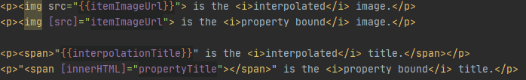
Basics: Databinding
ANGULAR
You often have a choice between interpolation and property binding. The following binding pairs do the same thing:
“When rendering data values as strings, there is no technical reason to prefer one form to the other, though readability tends to favor interpolation. However, when setting an element property to a non-string data value, you must use property binding.”
https://angular.io/guide/template-syntax#property-binding-vs-interpolation

Slide 39
Basics: Databinding
ANGULAR
Event binding
Event binding allows you to listen for certain events such as keystrokes, mouse movements, clicks, and touches.
Two-Way-databinding
For Two-Way-Binding to work, you need to enable the ngModel directive by adding the FormsModule to the imports[] array in the AppModule.
With two way databinding we combine property and event binding.
<button (click)="onNewStudent()">New Student</button>
<input name="lastName" [(ngModel)]="student.lastName" >
Notes:
Binding types and targets:
https://angular.io/guide/template-syntax#binding-types-and-targets

Slide 40
Directives

Slide 41
Directives: Definition
ANGULAR
Directives are classes which allow you to enrich and modify the view by simply adding HTML attributes to the template.
There are three kinds of directives in Angular:
Components: directives with a template.
Structural directives: change the DOM layout by adding and removing DOM elements, for example *ngFor and *ngIf.
Attribute directives: change the appearance or behavior of an element, component, or another directive, for example ngStyle

Slide 42
Directives: NgIf
ANGULAR
With else
<p *ngIf="boolean"></p>
<p *ngIf="boolean; else elseBlock "></p> <ng-template #elseBlock> </ng-template>

Slide 43
Directives: NgStyle
ANGULAR
with a Object:
<button [ngStyle]="{background: 'red'}">Click Me!</button>
with a function:
<p [ngStyle]="{backgroundColor:getColor()}"></p>
getColor(){ return this.status==='done'? 'green': 'red'; }

Slide 44
Directives: NgClass
ANGULAR
with a class name:
.online { color: blue; } .active { background-color: yellow; }
<p [ngClass]="'online'">paragraph 1</p>
with a multiple class name:
<p [ngClass]="'online active'">paragraph 1</p>
Conditionnal application of classes
<p [ngClass]="{ online: false, active: false }">paragraph 1</p>
With databinding
<p [ngClass]="{ online: !isValid }">paragraph 1</p>

Slide 45
Directives : NgFor
ANGULAR
Get the index
*ngFor="let std of students"
*ngFor="let std of students; let i= index"

Slide 46
Directives: NgSwitch
ANGULAR
<div [ngSwitch]="value"> <p *ngSwitchCase="5">Value is 5</p> <p *ngSwitchCase="10">Value is 10</p> <p *ngSwitchCase="100">Value is 100</p> <p *ngSwitchDefault>Value is default</p> </div>

Slide 47
Directives: Custom directives
ANGULAR
Creation with CLI: ng g d directive_name
Must be declared in the app.module
@Directive({ selector: '[appShadow]' }) export class ShadowDirectiveDirective { constructor(elem: ElementRef, renderer: Renderer2) { renderer.setStyle(elem.nativeElement, 'box-shadow', '2px 2px 12px #602593'); } }
@NgModule({ declarations: [ AppComponent, StudentComponent, ShadowDirectiveDirective ],
<div appShadow> … </div>
ElementRef : The "Dependency Injection" allows to retrieve via the ElementRef class, a reference to the object allowing to handle the associated DOM element

Slide 48
Directives Listener
ANGULAR
@HostListener('mouseenter') mouseOver(eventData:Event){ this.elementRef.nativeElement.style.backgroundColor='yellow'; } @HostListener('mouseleave') mouseLeave(eventData:Event){ this.elementRef.nativeElement.style.backgroundColor='transparent'; }
@HostListener () is a decorator allowing to add a "listener" on the element on which the directive is applied ("host element").

Slide 49
Using HostBinding to Bind to Host Properties
ANGULAR
Bind style.backgroundColor to the property backgroudColor:
@HostBinding('style.backgroundColor') backgroundColor:string='transparent'; @HostListener('mouseenter') mouseOver(eventData:Event){ this.backgroundColor='yellow'; } @HostListener('mouseleave') mouseLeave(eventData:Event){ this.backgroundColor='transparent'; }

Slide 50
Second Day
ANGULAR
Components & Databinding
Pipes
Services & Dependency Injection

Slide 51
Components & Databinding

Slide 52
Input: Property Binding
ANGULAR
To transmit data to a "child component", we will communicate with it in the same way as we control the properties of a native element, that is to say using the Property Binding:
<app-student-item *ngFor="let std of students" [student]="std">
</app-student-item>
This block of code will call an implicit "set" of the «student» property of the instance of the Parent component.

Slide 53
Input: @Input Decorator
ANGULAR
By default, no component property can be changed by Property Binding. It is therefore necessary to define the properties that can serve as "input" to the component by simply adding the decorator @Input().
export class StudentItemComponent implements OnInit { @Input() student: Student;
}

Slide 54
Input: Binding To custom property
ANGULAR
@Component({ selector: 'app-student-list', template: `
<app-student-item *ngFor="let std of students" [student]="std">
</app-student-item>` }) export class StudentListComponent implements OnInit { students: Student[] = []; }
@Component({ selector: 'app-student-item’, template: ` <h3>Name: {{student.name}}</h3> ` }) export class StudentItemComponent { @Input() student: Student; }

Slide 55
Input: Binding To custom property(alias)
ANGULAR
@Component({ selector: 'app-student-list', template: `
<app-student-item *ngFor="let std of students" [stdElm]="std">
</app-student-item>` }) export class StudentListComponent implements OnInit { students: Student[] = []; }
@Component({ selector: 'app-student-item’, template: ` <h3>Name: {{student.name}}</h3> ` }) export class StudentItemComponent { @Input('stdElm') student: Student; }

Slide 56
Output: Event Binding
ANGULAR
In the same way that Inputs allow you to communicate data to a "child component", Output can transmit data to the "parent component" via an "Output" mechanism similar to the Event Binding used previously to capture natives events.
<app-student-item *ngFor="let std of students" (studentSelected)="onSelectingStudent(std)">
</app-student-item>
The expression onSelectingStudent(std) allows to register a listener for the «studentSelected» event.
Note the similarity with the Event Binding on click event(or Other DOM events).
<button (click)="onSave()">Save</button>

Slide 57
Output: Declaration of property and decorator @Output ()
ANGULAR
By simply declaring the studentSelected property on the app-student-item component:
export class StudentItemComponent{ studentSelected= new EventEmitter<void>(); }
.. nothing happens, you must add the decorator @Output():
export class StudentItemComponent{ @Output() studentSelected= new EventEmitter<void>(); }
@Output allows you to make the eventEmitter listenable from the outside

Slide 58
Output: Sending values
ANGULAR
As indicated by his name, an EventEmitter allows you to emit values. It can therefore be used anywhere in the StudentItemComponent class to pass values to the parent component via the emit method.
<button mat-raised-button (click)="onClick()">Show</button>
onClick() { this.studentSelected.emit(); }

Slide 59
Output: Binding To custom event
ANGULAR
@Component({ selector: 'app-student-list', template: ` <app-student-item *ngFor="let std of students" [student]="std" (studentSelected)="onStudentSelected(std)"></app-student-item> ` }) export class StudentListComponent implements OnInit { students: Student[] = [ ]; onStudentSelected(student: Student) { console.log(student); } }
@Component({ selector: 'app-student-item', template: ` {{student.firstName}} {{student.lastName}} <button mat-raised-button (click)="onClick()">Show</button> ` }) export class StudentItemComponent{ @Input() student: Student; @Output() studentSelected = new EventEmitter<Student>(); onClick() { this.studentSelected.emit(this.student); } }

Slide 60
Local reference
ANGULAR
<input type="text" class="form-control" #serverNameInput> <button class="btn btn-primary" (click)="onAddServer(serverNameInput)">Add Server</button>
onAddServer(name:HtmlInputElement){ console.log(name.value); }

Slide 61
Pipes

Slide 62
Pipe
ANGULAR
Pipes are filters that can be used directly from the view in order to transform the values during the binding.
The Pipes syntax is simply inspired by UNIX shell Pipes found in many templating systems.
Pipes are added into template expressions using the pipe character (|).
<div>{{ user.firstName | lowercase }}</div>
{{ server.started | date}}
Angular has several native "pipes": https://angular.io/api?type=pipe

Slide 63
Pipe with parameters
ANGULAR
Pipes can take parameters that must be puted after the Pipe and separated with the symbol ":".
<div>{{ user.firstName | slice:0:10 }}</div>
{{ student.birthDate | date:'fullDate'}}

Slide 64
Chaining
ANGULAR
The "pipes" can be chained.
<div>{{ student.firstName | slice:0:10 | lowercase }}</div>
{{ server.started | date:'fullDate'| uppercase}}

Slide 65
Creating a Custom Pipe
ANGULAR
To create a custom Pipe, you need:
Create a class that implements the PipeTransform interface,
decorate this class with the decorator @Pipe () by indicating the name of the Pipe.
add the class to the declarations (and exports) of the associated module.
Creation with angular CLI: ng g p namePipe

Slide 66
Creating a Custom Pipe
ANGULAR
import { PipeTransform } from "@angular/core"; @Pipe({ name:'shorten' }) export class ShortenPipe implements PipeTransform{ transform(value:any){ if(value.length>10){ return value.substr(0,10)+'...'; } return value; } }
{{ student.firstName | shorten }}

Slide 67
parametrizing a custom pipe
ANGULAR
import {PipeTransform} from "@angular/core"; @Pipe({ name: 'shorten' }) export class ShortenPipe implements PipeTransform { transform(value: any, limit: number) { if (value.length > limit) { return value.substr(0, limit) + '...'; } return value; } }
{{ student.firstName | shorten:5 }}
{{ student.firstName | shorten:5:arg2:arg3 }}

Slide 68

Services & Dependency Injection

Slide 69
What is "Dependency Injection"?
ANGULAR
The "Dependency Injection" is a "design pattern" which consists in separating the instantiation (and therefore the implementation) of a dependency and its use.
It decreases coupling between a class and its dependency.
Extending the application becomes easier.
Helps in Unit testing.

Slide 70
Injection of an Angular Service
ANGULAR
With Angular, a dependency is generally the instance of a class allowing to factorize certain functionalities or to access a state thus allowing the components to communicate with each other.
In the Angular vocabulary, these classes are called "services".
An Angular service can be injected by any Angular class (i.e.: component, Directive, Service or Pipe) via the parameters of its constructor.
export class StudentListComponent { constructor(private studentService: StudentService) { } }

Slide 71

Declaration of a Service
ANGULAR
To declare an Angular service, just create a TypeScript class and decorate it with the decorator @Injectable ().
@Injectable() export class StudentService { }
@Injectable(): Decorator that marks a class as available to be provided and injected as a dependency.
@NgModule({ providers: [StudentService], bootstrap: [AppComponent] }) export class AppModule { }
In order to instantiate a service, Angular needs a "provider" telling it how to produce the instance of this service.
This is generally done via the providers property in the app module.

Slide 72
Scope of Services
ANGULAR
AppModule
AppComponent
Any Other Component
Same instance of Service is available Application-wide
Same instance of Service is available for all Components(but Not for other services)
Same instance of Service is available for the Component and all its child components

Slide 73
Services in Angular 6+
ANGULAR
Since Angular 6, it is no longer necessary to define "providers" at the module level.
Instead of adding a service class to the providers[] array in AppModule , you can set the following config in @Injectable() :
@Injectable({ providedIn: 'root' }) export class StudentService {
}

Slide 74
Third Day
ANGULAR
Routing
Observables
Forms: Template driven

Slide 75

Routing

Slide 76
Routing definition
ANGULAR
Routing is the mechanism that allows you to navigate from one page to another on a website.
The Angular router is a core part of the Angular platform.
It enables developers to build Single Page Applications with multiple views and allow navigation between these views.

Slide 77
Setting up of "Routing"
ANGULAR
The "Routing" configuration is transmitted to the RouterModule module when it is imported by the AppModule "root module".
const appRoutes: Routes = [ {path: '', redirectTo: '/students', pathMatch: 'full'}, {path: 'students', component: StudentComponent}, {path: 'classrooms', component: ClassroomComponent} ]; @NgModule({ imports: [RouterModule.forRoot(appRoutes)], exports: [RouterModule] }) export class AppRoutingModule { }
it is recommended to place this configuration in a dedicated module AppRoutingModule imported by the "root module" AppModule.
ng generate module app-routing --flat --module=app

Slide 78
Setting up routes with parameters
ANGULAR
The path of a "route" can define mandatory parameters with the prefix :
{path: 'students/:id', component: StudentDetailsComponent}

Slide 79
<router-outlet>
ANGULAR
The configuration of "Routing" allows you to define which component to display according to the route but this does not tell Angular where to inject the component in the page.
To indicate the the loading location of the routes, use the <router-outlet> directive directly in the "root component" AppComponent (or another one).
<router-outlet></router-outlet>

Slide 80
Navigating with Router Links
ANGULAR
Using native links <a href="/students">, the "browser" will generate an HTTP GET request to the server and reload the entire application.
To avoid this problem, the Angular Routing module provides the routerLink directive which allows to intercept the click event on the links and to change the "route" without reloading the whole application.
<a mat-button routerLink="/students">Students</a>

Slide 81
Navigating Programmatically
ANGULAR
The navigatation can be done programmatically with the Router object
import {Router} from "@angular/router";
…
constructor(private router: Router) { }
…
this.router.navigate(['/students']);

Slide 82
Styling Active Router Links
ANGULAR
<a mat-button routerLink="/" routerLinkActive="active" [routerLinkActiveOptions]="{exact:true}">Home</a> <a mat-button routerLink="/students" routerLinkActive="active">Students</a> <a mat-button routerLink="/classrooms" routerLinkActive="active">Classrooms</a>
[routerLinkActiveOptions]="{exact:true}"
Do not activate the routerLinkActive only if the url is exactly ‘/’

Slide 83
Child(Nested) Route
ANGULAR
A child route is like any other route, in that it needs both a path and a component.
The one difference is that you place child routes in a children array within the parent route
{path: 'students', component: StudentComponent, children: [ {path: '', component: StudentListComponent}, {path: 'new', component: CreateStudentComponent}, {path: ':id', component: UpdateStudentComponent} ]},
Must add <router-outlet></router-outlet> in the Html of the Student component

Slide 84
Passing Parameters to Routes
ANGULAR
Configuration:
Calling the route:
…
{path: ':id', component: StudentDetailsComponent}
…
<a [routerLink]="['/students',5]" ></a>
Or programmatically
this.router.navigate(['/students', idStudent]);

Slide 85
Fetching Route Parameters
ANGULAR
import {ActivatedRoute} from "@angular/router";
constructor(private route: ActivatedRoute) { this.id = this.route.snapshot.params['id']; }

Slide 86
Fetching Route Parameters Reactively
ANGULAR
constructor(private route: ActivatedRoute) {
this.id = this.route.snapshot.params['id']; this.route.params .subscribe( (params:Params)=>{ this.id = params['id']; }); }

Slide 87
QueryParams
ANGULAR
<a [routerLink]="['/students']" [queryParams]="{allowEdit:'1'}"></a>
Or programmatically
this.router.navigate([‘/students'],{queryParams:{allowEdit:'1'}});
How to access these values:
With observable:
this.route.snapshot.queryParams
this.route.queryParams.subscribe();

Slide 88
Redirecting and Wildcard Routes
ANGULAR
{path:'not-found',component:PageNotFoundComponent}, {path:'**', redirectTo:'/not-found’}
The path:'**' must be the last route in the appRoutes

Slide 89
Guards
ANGULAR
"Guards" are used to control access to a "route" (e.g. authorization) or departure from a "route".
Configuration:
The "Guards" are added in "Routing" configuration:
{path: 'classrooms', component: ClassroomComponent,canActivate:[IsSignedInGuard]}

Slide 90
CanActivate
ANGULAR
An activation guard is a service that implements the CanActivate interface.
This service must therefore implement the canActivate method which is called on each request for access to the "route"; it must then return a value of type boolean or Promise <boolean> or Observable <boolean> indicating whether access to the "route" is authorized or not.
@Injectable({ providedIn: 'root' }) export class IsSignedInGuard implements CanActivate { constructor(private _session: Session) { } canActivate(route: ActivatedRouteSnapshot, state: RouterStateSnapshot) { return this._session.isSignedIn(); } }

Slide 91
CanDeactivate
ANGULAR
A deactivation guard is a service that implements the CanDeactivate interface.
This service must implement the canDeactivate method.
This method is called whenever the user wishes to leave the route. it must then return a value of type boolean or Promise <boolean> or Observable <boolean> indicating whether access to the "route" is authorized or not.
@Injectable({ providedIn: 'root' }) export class IsNotDirtyGuard implements CanDeactivate<ProfileViewComponent> { canDeactivate(component: ProfileViewComponent, currentRoute: ActivatedRouteSnapshot, currentState: RouterStateSnapshot, nextState?: RouterStateSnapshot): Observable<boolean> | Promise<boolean> | boolean { return component.isDirty(); } }
export class ProfileViewComponent { isDirty() { return false; } }

Slide 92
Lazy Loading
ANGULAR
When the application starts, Angular loads all the modules and all the entities of the application.
If the application is very large then the startup will be slower.
To avoid these scalability problems, Angular allows modules to be loaded on demand (i.e. "Lazy Loading") in order to ease the initial load of the application.

Slide 93
Lazy Loading configuration
ANGULAR
The configuration of "Lazy Loading" is done in the "Routing" configuration.
The AppRoutingModule "Routing" module can delegate the "Routing" management of a part of the application to another module. This "Lazy Loaded" module will therefore be loaded asynchronously when visiting the "routes" for which it is responsible.
{ path: 'classrooms', loadChildren: ‘./classrooms/classroom-routing.module#ClassroomRoutingModule' },
This configuration delegates the "Routing" of all the /classrooms/... part of the application to the ClassroomRoutingModule module.

Slide 94
Observables

Slide 95
Async Requests
ANGULAR
'Asynchrony' in the computer world means that the flow of the program occurs independently. It does not wait for a task to get finished. It moves to the next task.
In the background, a co-worker works and handles those unfinished tasks and once they are done, it sends data back.
This can bring up another question of how we handle the data that is returned. The answer is Promises, Observables, callbacks and many more.
An Async request is one where the client does not wait for the response.

Slide 96
Callbacks
ANGULAR
Callback functions (as their name suggests) are called at the back. That is when the request gets completed and returns the data or error, these functions get called.
const request = require(‘request’);
request('https://www.example.com', function (err, response, body) {
if(error){
// Error handling
}
else {
// Success
}
});

Slide 97
Promises(1/2)
ANGULAR
Promises are objects that promise they will have value in the near future - either a success or failure.
Promises have their own methods which are then and catch. .then() is called when success comes, else the catch() method calls.
Promises are created using the promise constructor:
new Promise( /* executor */ function(resolve, reject) { ... } );
If the asynchronous operations are successful then the expected result is returned by calling the resolve function by the creator of the promise. Similarly if there was some unexpected error the reasons is passed on by calling the reject function.

Slide 98
Promises(2/2)
ANGULAR
const promiseToReader = new Promise((resolve, reject) => {
setTimeout(function() {
if (userLikedTheArticle) {
resolve('This article is awesome!')
} else {
reject('Not very good')
}
}, enoughToReadArticle)
})
promiseToReader.then(result => {
console.log('result', result)
})
promiseToReader.catch(error => {
console.error('error', error)
})

Slide 99
Observables
ANGULAR
An Observable is an object allowing to make the “link” between publishers and subscribers.
An Observable is basically a function that can return a stream of values to an observer over time, this can either be synchronously or asynchronously.
Angular makes use of observables as an interface to handle a variety of common asynchronous operations.
Observables will emit events which will be intercepted by observers.

Slide 100
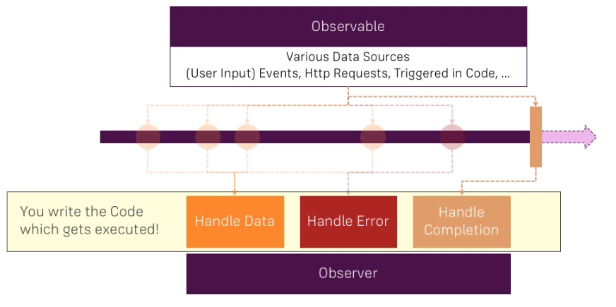
Observables
ANGULAR
Notes:
An observable basically can be thought of as a data source.
On the timeline(or stream), we can have multiple events emitted by the observable or data packages,
So the observable could emit data because you trigger it to do so,
it could be connected to a button and therefore whenever the button is clicked, an event in a data package
is emitted automatically or as the Angular HTTP service does it,
it's connected to a HTTP request.
the observer, this actually is your code you could say.
you can handle the normal data, you can handle errors or you can handle the completion of the observable
There observables that complete such as http request and other dosen’t such as button
Used to handle asychnronus tasks

Slide 101
Observers
ANGULAR
A handler for receiving observable notifications implements the Observer interface.
NOTIFICATION TYPE | DESCRIPTION
next | Required. A handler for each delivered value. Called zero or more times after execution starts.
error | Optional. A handler for an error notification. An error halts execution of the observable instance.
complete | Optional. A handler for the execution-complete notification.

Slide 102
Subscribe to an observable
ANGULAR
In the example below we will create an observable using the interval function which produces a self-incrementing value on a regular basis.
import { interval } from 'rxjs'; const data$ = interval(1000);
As long as you don't subscribe to the "observable", nothing happens because this observable is "lazy".
The common point between all "observables" is the subscribe method which allows you to subscribe to an Observable and be notified of new values, errors or the end of the "stream".
const subscription =data$.subscribe({ next: value => console.log(value), error: err => console.error(err), complete: () => console.log('DONE!') });

Slide 103
Unsubscription
ANGULAR
The subscribe method returns an object of type Subscription.
This object is mainly used to unsubscribe from an Observable via its unsubscribe method.
subscription.unsubscribe ();
The unsubscribe method allows you to:
unsubscribe the "callbacks": next, error and complete;
destroy the Observable (interrupt the processing carried out by the Observable)
possibly free the memory because by unregistering the "callbacks" .

Slide 104
Promises vs observables
ANGULAR
Observables are lazy whereas promises are not:
observables are lazy, that is we have to subscribe observables to get the results. In the case of promises, they execute immediately.
Observables handle multiple values unlike promises:
Promises can only provide a single value whereas observables can give you multiple values.
Observables are cancelable:
You can cancel observables by unsubscribing it using the unsubscribe method whereas promises don’t have such a feature.
Observables provide many operators:
There are many operators like map, forEach, filter etc. Observables provide these whereas promises does not have any operators in their bucket.

Slide 105
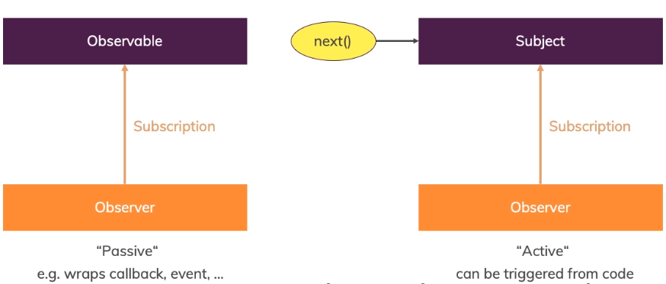
Subject
ANGULAR
A Subject is a special kind of Observable
Notes:
A subject is different, a subject also is an object you can subscribe to but it's more active because you can actively call next on it from outside.
EventEmitter must be use with output otherways use subject

Slide 106
Subject
ANGULAR
A Subject is both an observable AND an observer. We can therefore subscribe to it, but also send it values
const subject = new Subject<number>(); subject.subscribe((number) => { console.log( number); }); subject.next(1); // send value subject.next(2); // send another

Slide 107
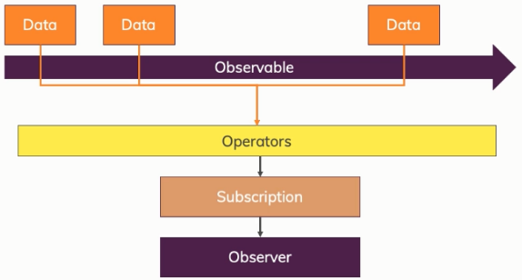
Operators
ANGULAR
An operator makes it possible to define an Observable from another by applying some transformations to it.
Operators are functions that can be applied to an Observable via the pipe method.

Slide 108
map
ANGULAR
The map operator allows you to create a new Observable from the original Observable by transforming each of its values.
import { from } from 'rxjs'; import { map } from 'rxjs/operators'; //emit (1,2,3,4,5) const source = from([1, 2, 3, 4, 5]); //add 10 to each value const example = source.pipe(map(val => val + 10)); //output: 11,12,13,14,15 const subscribe = example.subscribe(val => console.log(val));

Slide 109
filter
ANGULAR
The filter operator allows you to keep only the elements for which the predicate function returns true.
import { from } from 'rxjs'; import { filter } from 'rxjs/operators'; //emit (1,2,3,4,5) const source = from([1, 2, 3, 4, 5]); //filter out non-even numbers const example = source.pipe(filter(num => num % 2 === 0)); //output: "Even number: 2", "Even number: 4" const subscribe = example.subscribe(val => console.log(`Even number: ${val}`));

Slide 110

Forms: Template driven

Slide 111
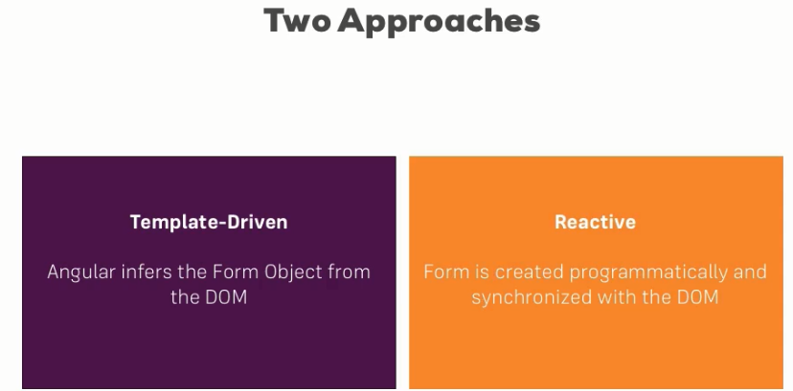
Forms
ANGULAR

Slide 112
TD vs Reactive
Template Driven Forms Features | Reactive Forms Features
Easy to use | More flexible, but needs a lot of practice
Suitable for simple scenarios | Handles any complex scenarios
Two way data binding(using [(NgModel)] syntax) | No data binding is done
Minimal component code | More component code and less HTML markup
Automatic track of the form and its data(handled by Angular) | Adding elements dynamically

Slide 113
TD: Registering the Controls
ANGULAR
First of all the module FormsModule must be imported in the app.module
To register a control we have to add NgModel and a name for this control
<form> <input type="text" id="username" class="form-control" ngModel name="username"> </form >

Slide 114
TD: Submitting and Using the Form
ANGULAR
<form (ngSubmit)="onSubmit(f)" #f="ngForm"> ... </form >
import { NgForm } from '@angular/forms’; … onSubmit(form:NgForm){ console.log(form); }

Slide 115
TD: Adding Validation to check User Input
ANGULAR
<input type="text" id="username" class="form-control" ngModel name="username" required minlength="4">

Slide 116
TD: Using form state
ANGULAR
<button type="submit" [disabled]="!f.valid">Submit</button>
input.ng-invalid, select.ng-invalid { border: 1px solid red; }

Slide 117
TD: Outputting Validation Error Messages
ANGULAR
<input type="email" id="email" class="form-control" ngModel name="email" required email #email="ngModel"> <span class="help-block" *ngIf="!email.valid && email.touched"> Please enter a valid email </span>

Slide 118
TD: Grouping Form Controls
ANGULAR
<div id="user-data" ngModelGroup="userData" #userData="ngModelGroup"> … control s here </div> <p *ngIf="!userData.valid && userData.touched">user Data is invalid</p>

Slide 119
TD: Handling Radio Buttons
ANGULAR
<div class="radio" *ngFor="let g of genders"> <label> <input type="radio" name="gender" ngModel [value]="g">{{g}} </label> </div>
genders=['male','female'];

Slide 120
TD: Using Form Data
ANGULAR
user={ username:'', email:'', secretQuestion:'', answer:'', gender:'' }; … onSubmit(myForm:NgForm){ this.user.username=this.myForm.value.userData.username; this.user.email=this.myForm.value.userData.email; this.user.gender=this.myForm.value.gender; this.user.secretQuestion=this.myForm.value.secret; this.user.answer=this.myForm.value.questionAnswer; }

Slide 121
TD: Reset a form
ANGULAR
this.myForm.reset();

Slide 122
Fourth Day
ANGULAR
Forms: Reactive
Making Http Requests
Authentication

Slide 123
Forms: Reactive

Slide 124
Reactive: Adding a basic form control (1/2)
ANGULAR
There are three steps to using form controls.
Register the reactive forms module in your app. This module declares the reactive-form directives that you need to use reactive forms.
Generate a new FormControl instance and save it in the component.
Register the FormControl in the template.

Slide 125
Reactive: Adding a basic form control (2/2)
ANGULAR
Generate a new FormControl
name = new FormControl('');
Register the control in the template
<label> Name: <input type="text" [formControl]="name"> </label>
Displaying a form control value
<p> Value: {{ name.value }} </p>

Slide 126
Reactive: Creation of the form
ANGULAR
signupFrom: FormGroup; ngOnInit(){ this.signupFrom= new FormGroup({ 'username': new FormControl(null), 'email': new FormControl(null), 'gender': new FormControl('male') }); }

Slide 127
Reactive: Syncing HTML and Form
ANGULAR
<form [formGroup]="signupFrom"> <div class="form-group"> <label for="username">Username</label> <input type="text" id="username" formControlName="username" class="form-control"> </div> </form>

Slide 128
Reactive: submit de form
ANGULAR
The FormGroup directive listens for the submit event emitted by the form element and emits an ngSubmit event that you can bind to a callback function.
<form [formGroup]="signupFrom" (ngSubmit)="onSubmit()"> ... <button type="submit">Submit</button> </form>
onSubmit(){ console.log(this.signupFrom.value); }

Slide 129
Reactive: Validation
ANGULAR
import { Validators } from '@angular/forms’;
…
this.signupFrom= new FormGroup({ 'username': new FormControl(null, Validators.required), 'email': new FormControl(null, [Validators.required,Validators.email]), 'gender': new FormControl('male') });

Slide 130
Reactive: Getting Access to Controls
ANGULAR
<span *ngIf="!signupFrom.get('username').valid && signupFrom.get('username').touched" class="help-block"> Please enter a valid username </span>
input.ng-invalid.ng-touched { border: 1px solid red; }

Slide 131
Reactive: Creating nested form groups(1/2)
ANGULAR
<form [formGroup]="signupFrom"> <div class="form-group"> <label for="username">Username</label> <input type="text" id="username" formControlName="username" class="form-control"> </div> ... <div formGroupName="userData"> <div class="form-group"> <label for="username">Username</label> <input type="text" id="username" formControlName="username" class="form-control”> </div> <div class="form-group"> <label for="email">email</label> <input type="text" id="email" formControlName="email" class="form-control"> </div> </div> </form>

Slide 132
Reactive: Creating nested form groups(2/2)
ANGULAR
this.signupFrom= new FormGroup({ 'username': new FormControl(null, Validators.required), 'email': new FormControl(null, [Validators.required,Validators.email]), 'gender': new FormControl('male'), 'userData':new FormGroup({ 'username': new FormControl(null, Validators.required), 'email': new FormControl(null, [Validators.required,Validators.email]) }) });

Slide 133
Reactive: Creating dynamic forms
ANGULAR
In order to declare controls dynamically we use FormArray
You can initialize a form array with any number of controls, from zero to many, by defining them in an array.
this.signupFrom= new FormGroup({ …, 'hobbies':new FormArray([]) });

Slide 134
Reactive: Access the FormArray control
ANGULAR
We can create a get method that return the controlls of the array
getControls() { return (<FormArray>this.signupForm.get('hobbies')).controls; }
Define a method to dynamically insert an alias control into the alias's form array. The FormArray.push() method inserts the control as a new item in the array.
onAddHobby(){ const control=new FormControl(null,Validators.required); (<FormArray>this.signupFrom.get('hobbies')).push(control); }

Slide 135
Reactive:Display the form array in the template
ANGULAR
<form [formGroup]="signupFrom"> ... <div formArrayName="hobbies"> <h4>Your hobbies</h4> <button class="btn btn-default" type="button" (click)="onAddHobby()"> Add Hobby</button> <div class="form-group" *ngFor="let hobby of getControls(); let i=index"> <input type="text" class="form-control" [formControlName]="i"> </div> </div> </form>

Slide 136
Updating parts of the data model
ANGULAR
There are two ways to update the model value:
Use the setValue() method to set a new value for an individual control. The setValue() method strictly adheres to the structure of the form group and replaces the entire value for the control.
Use the patchValue() method to replace any properties defined in the object that have changed in the form model.

Slide 137

Http Requests

Slide 138
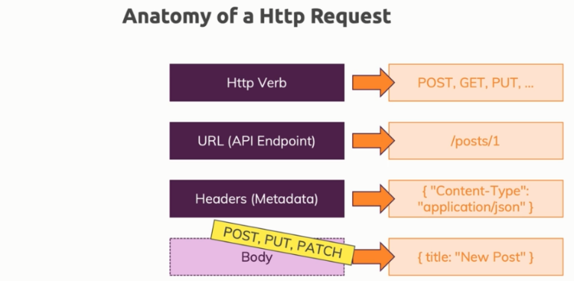
Making HTTP Requests
ANGULAR

Slide 139
Use of HttpClient
ANGULAR
must import the module HttpClientModule in app.module
import { HttpClientModule } from '@angular/common/http'
HttpClient is an Angular service; we can therefore recover it with the Dependency Injection.
constructor(private httpClient: HttpClient) { }

Slide 140
Sending a POST Request
ANGULAR
constructor(private http: HttpClient) {} addHero (hero: Hero): Observable<Hero> { return this.http.post<Hero>(this.heroesUrl, hero); }
this.heroesService.addHero(newHero) .subscribe( hero => this.heroes.push(hero) );

Slide 141
Sending a PUT Request
ANGULAR
constructor(private http: HttpClient) {} updateHero (hero: Hero): Observable<Hero> { return this.http.put<Hero>(this.heroesUrl, hero); }

Slide 142
GETting Data
ANGULAR
private fetchPosts() { this.http .get(url) .subscribe(posts => { console.log(posts); }); }

Slide 143
Delete request
ANGULAR
deleteHero (id: number): Observable<{}> { const url = `${this.heroesUrl}/${id}`; // DELETE api/heroes/42 return this.http.delete(url); }
this.heroesService .deleteHero(hero.id).subscribe();

Slide 144
Handling Errors
ANGULAR
this.postService.fetchPosts().subscribe(posts=>{ this.loadedPosts = posts; }, error => { this.error = error.message; } );
<div class="alert alert-danger" *ngIf="error"> <h1>An error has occured</h1> <p>{{error}}</p> </div>

Slide 145
Setting Headers
ANGULAR
return this.http .get<{ [key: string]: Post }>( url, { headers: new HttpHeaders({'Custom-header' : 'hello'}) } )

Slide 146
Adding Query Params
ANGULAR
let searchParams = new HttpParams(); searchParams = searchParams.append('print', 'pretty'); searchParams = searchParams.append('custom', 'key'); return this.http .get<{ [key: string]: Post }>( url, { headers: new HttpHeaders({'Custom-header' : 'hello'}), params: searchParams } )

Slide 147
Introducing Interceptors
ANGULAR
export class AuthInterceptorService implements HttpInterceptor { intercept(req: HttpRequest<any>, next: HttpHandler) { const modifiedReq = req.clone({ headers: req.headers.append('Auth', 'xyz') }); return next.handle(req); } }
@NgModule({ … providers: [{provide : HTTP_INTERCEPTORS, useClass: AuthInterceptorService, multi : true}], … })

Slide 148
Authentication

Slide 149
How authentication works
ANGULAR
Storage
Stores the token
Client
Send Auth Data
Send the token in requests
Token
Session
Server
Notes:
Session?:
- can’t be used because the server and client are decoupled
- The backends are stateless

Slide 150

QUESTIONS
ANGULAR

Slide 151
SESSION END
ANGULAR
THANK YOU
for
your
ATTENTION

Slide 152
ANNEX
ANGULAR

Slide 153
Source code
ANGULAR
Source code can be found in this github Link:
https://github.com/youma85/schoolAng

Slide 154
TypeScript(Types)
ANGULAR
In typeScript, type System represents different types of datatypes which are supported by TypeScript.
BUILT-IN DATA TYPE | KEYWORD | DESCRIPTION
Number | number | It is used to represent both Integer as well as Floating-Point numbers
Boolean | boolean | Represents true and false
String | string | It is used to represent a sequence of characters
Void | void | Generally used on function return-types
Null | null | It is used when an object does not have any value
Undefined | undefined | Denotes value given to uninitialized variable
Any | any | If variable is declared with any data-type then any type of value can be assigned to that variable

Slide 155
TypeScript(Classes)
ANGULAR
TypeScript is object oriented JavaScript. TypeScript supports object-oriented programming features like classes, interfaces, etc. A class in terms of OOP is a blueprint for creating objects. A class encapsulates data for the object.
class Car {
//field
engine:string;
//constructor
constructor(engine:string) {
this.engine = engine
}
//function
disp():void {
console.log("Engine is : "+this.engine)
}
}

Slide 156
TypeScript(Interfaces)
ANGULAR
An interface is a syntactical contract that an entity should conform to. In other words, an interface defines the syntax that any entity must adhere to.
interface IPerson {
firstName:string,
lastName:string,
sayHi: ()=>string
}

Slide 157
ES6+:versions (from www.w3schools.com)
ANGULAR
Ver | Official Name | Description
1 | ECMAScript 1 (1997) | First Edition.
2 | ECMAScript 2 (1998) | Editorial changes only.
3 | ECMAScript 3 (1999) | Added Regular Expressions. Added try/catch.
4 | ECMAScript 4 | Never released.
5 | ECMAScript 5 (2009) | Added "strict mode". Added JSON support. Added String.trim(). Added Array.isArray(). Added Array Iteration Methods.
5.1 | ECMAScript 5.1 (2011) | Editorial changes.
6 | ECMAScript 2015 | Added let and const. Added default parameter values. Added Array.find(). Added Array.findIndex().
7 | ECMAScript 2016 | Added exponential operator (**). Added Array.prototype.includes.
8 | ECMAScript 2017 | Added string padding. Added new Object properties. Added Async functions. Added Shared Memory.
9 | ECMAScript 2018 | Added rest / spread properties. Added Asynchronous iteration. Added Promise.finally(). Additions to RegExp.

Slide 158
ES6+: var vs. let vs. const
ANGULAR
The let statement allows you to declare a variable with block scope.
The const statement allows you to declare a constant.
Constants are similar to let variables, except that the value cannot be changed..
var x = 10; // Here x is 10 { let x = 2; // Here x is 2 } // Here x is 10
const user = {
firstName: 'Foo',
lastName: 'BAR’
}
user = user.firstName; // TypeError: Assignment to constant variable.

Slide 159
ES6+: Arrow Functions
ANGULAR
Arrow functions allows a short syntax for writing function expressions.
You don't need the function keyword, the return keyword, and the curly brackets.
They must be defined before they are used.
// ES5 var x = function(x, y) { return x * y; } // ES6 const x = (x, y) => x * y;

Slide 160
ES6+: Classes
ANGULAR
A class is a type of function, but instead of using the keyword function to initiate it, we use the keyword class, and the properties are assigned inside a constructor() method.
class Student { constructor(name) { this.name = name; } }

Slide 161
ES6+: Template String
ANGULAR
const appName = 'Wishtack';
const userName = 'Foo’;
const greetings = `Hi ${userName},
Welcome to ${appName}!`
console.log(greetings);
// Result:
// Hi Foo,
// Welcome to Wishtack!

Slide 162
ES6+: Default Parameter Values
ANGULAR
ES6 allows function parameters to have default values.
function myFunction(x, y = 10) { // y is 10 if not passed or undefined return x + y; } myFunction(5); // will return 15

Slide 163
ES6+: Other Features
ANGULAR
You can find more features on the following link:
http://es6-features.org/

Slide 164
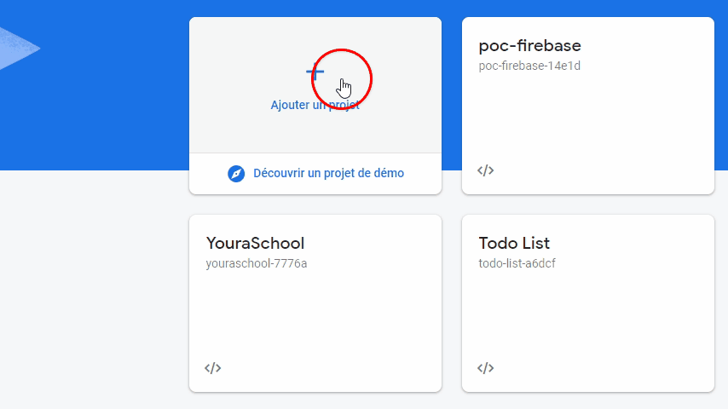
Create a firebase project
ANGULAR

Slide 165
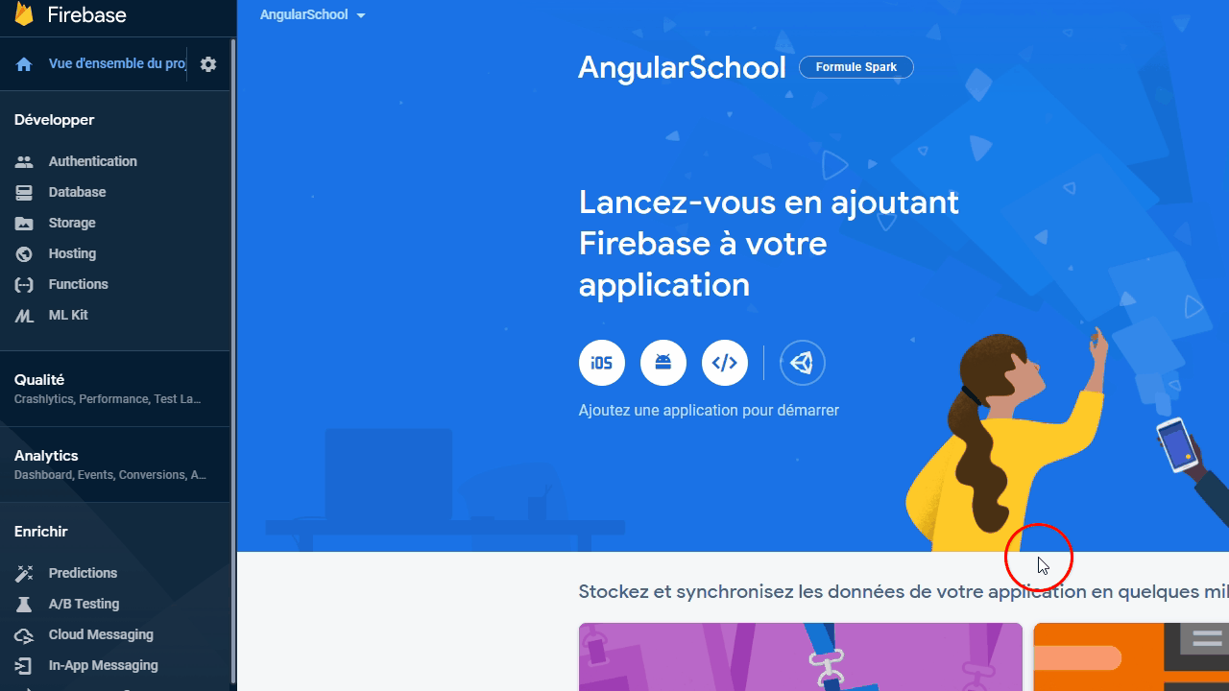
Create an application
ANGULAR

